Slide 1
Relational Database Service
Velocity training institute
Shantanu Mahajan (sr engg devops)

Slide 2
RDS (relational Database Service)
Suppose we have to create a Database, so traditionally we install a OS and install the database such as oracle, MySQL etc. on that OS and call it as a DB server.
The entire DB server management right from installation and its maintenance is on our side, for e.g. replication, backups etc.
But with the help of AWS RDS the db. server maintenance is taken care by Amazon.
So we need to launch RDS and start using it directly.
No need to create DB backups manually its taken care buy AWS itself.

Slide 3
RDS
Amazon Relational Database Service (Amazon RDS) makes it easy to set up, operate, and scale a relational database in the cloud.
It provides cost-efficient and resizable capacity while automating time-consuming administration tasks such as hardware provisioning, database setup, patching and backups.
It frees you to focus on your applications so you can give them the fast performance, high availability, security and compatibility they need.
Amazon RDS is available on several database instance types - optimized for memory, performance or I/O - and provides you with six familiar database engines to choose from, including Amazon Aurora, PostgreSQL, MySQL, MariaDB, Oracle Database, and SQL Server.

Slide 4
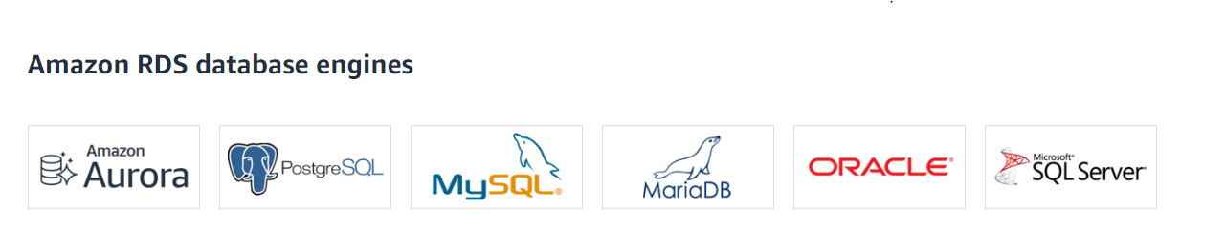
Available Amazon DB engines

Slide 5
benefits
Easy to administer:-
Amazon RDS makes it easy to go from project conception to deployment. Use the Amazon RDS Management Console, the AWS RDS Command-Line Interface, or simple API calls to access the capabilities of a production-ready relational database in minutes. No need for infrastructure provisioning, and no need for installing and maintaining database software.
Highly scalable
You can scale your database's compute and storage resources with only a few mouse clicks or an API call, often with no downtime.
Available and Durable
Fast
Secure
Inexpensive
RDS users can use AWS Identity and Access Management to define and set permissions for who can access an RDS database.

Slide 6
Pricing
750 hours of Amazon RDS Single-AZ db.t2.micro Instance usage running MySQL, MariaDB, PostgreSQL, Oracle BYOL, or SQL Server (running SQL Server Express Edition).
20 GB of General Purpose (SSD) DB Storage.
20 GB of storage for your automated database backups and any user-initiated DB Snapshots.

Slide 7
Features
Replication.
RDS uses the replication feature to create read replicas.
These are read-only copies of database instances that applications use without altering the original production database.
Administrators can also enable automatic failover across multiple availability zones through RDS Multi-AZ deployment and with synchronous data replication.

Slide 8
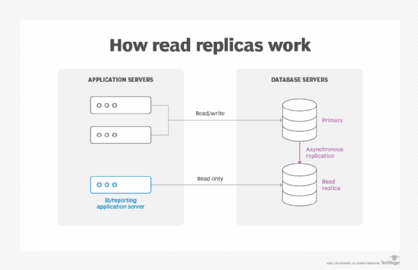
Read Replica

Slide 9
Features
Storage. RDS provides three types of storage:
General-purpose solid-state drive (SSD). Amazon recommends this storage as the default choice.
Provisioned input-output operations per second (IOPS). SSD storage for I/O-intensive workloads.
Magnetic. A lower cost option.

Slide 10
Features
Monitoring.
The Amazon CloudWatch service enables managed monitoring. It lets users view capacity and I/O metrics.
Patching. RDS provides patches for whichever database engine the user chooses.
Backups. Another feature is failure detection and recovery. RDS provides managed instance backups with transaction logs to enable point-in-time recovery. Users pick a retention period and restore databases to any time during that period. They also can manually take snapshots of instances that remain until they are manually deleted.
Pay as you go

Slide 11
Components of RDS
DB Instances:-
They are the building blocks of RDS. It is an isolated database environment in the cloud, which can contain multiple user-created databases, and can be accessed using the same tools and applications that one uses with a stand-alone database instance.
A DB Instance can be created using the AWS Management Console , the Amazon RDS API, or the AWS Command line Interface .
The computation and memory capacity of a DB Instance depends on the DB Instance class. For each DB Instance you can select from 5GB to 6TB of associated storage capacity.

Slide 12
Components
Security Groups:-
A security group controls the access to a DB Instance. It does so by specifying a range of IP addresses or the EC2 instances that you want to give access.
DB Parameter groups:-
It contains the engine configuration values that can be applied to one or more DB Instances of the same instance type.
If you don’t apply a DB Parameter group to your instance, you are assigned a default Parameter group which has the default values.
DB Option groups
Some DB engines offer tools that simplify managing your databases.
RDS makes these tools available with the use of Option groups.

